Slide 1
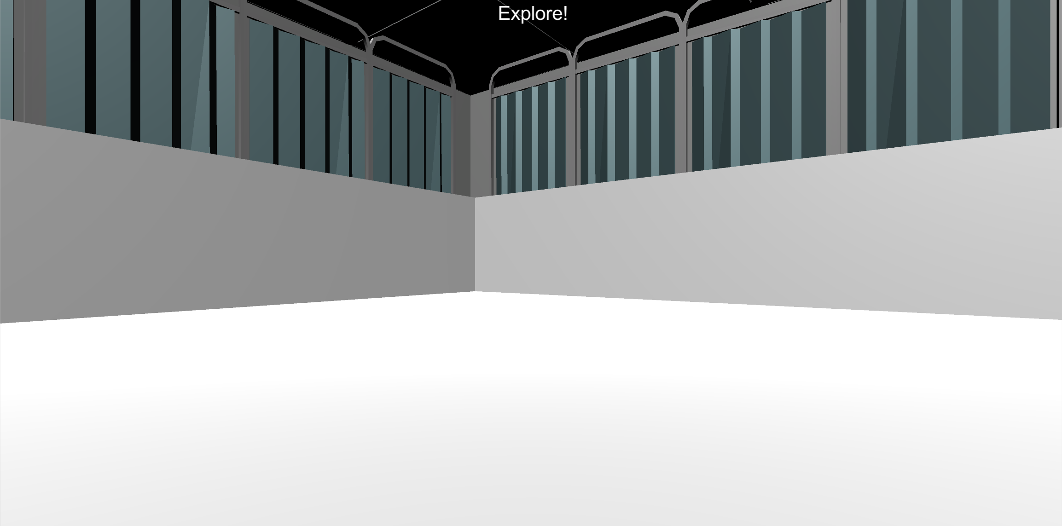
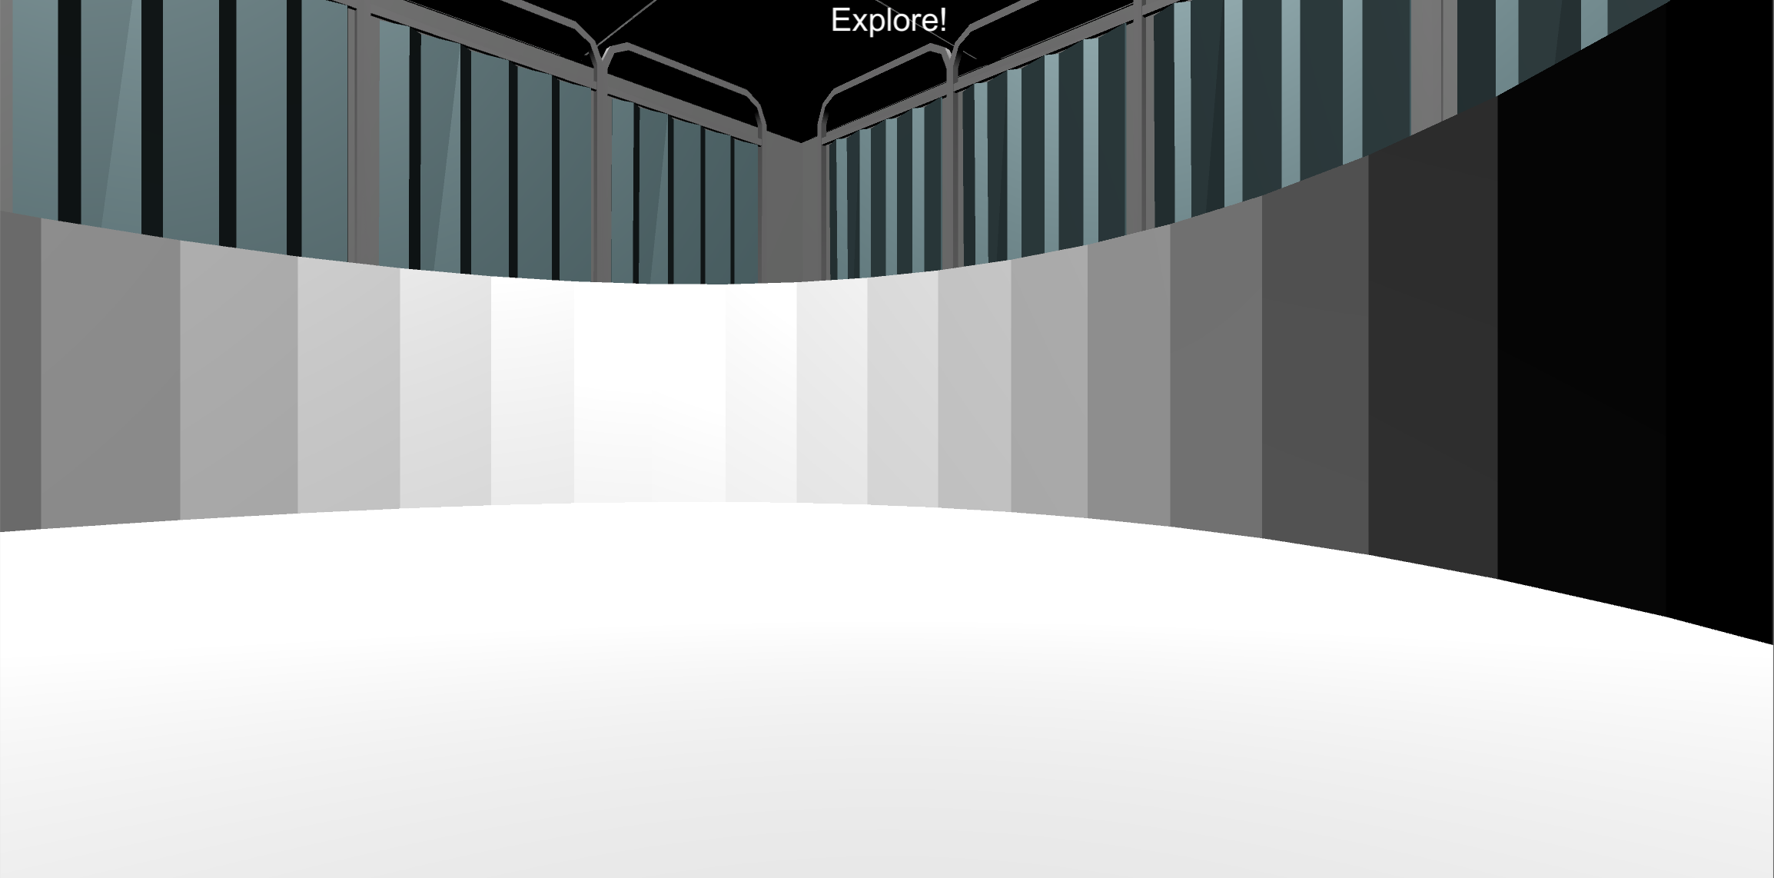
Welcome!
1
In this final session of the experiment, your job is to find as much money as possible in the environments that you’ve learned over the course of this experiment.
Search For Money
Search For Money

Slide 2
Welcome!
2
In this final session of the experiment, your job is to find as much money as possible in the environments that you’ve learned over the course of this experiment.
Search For Money
Search For Money

Slide 3

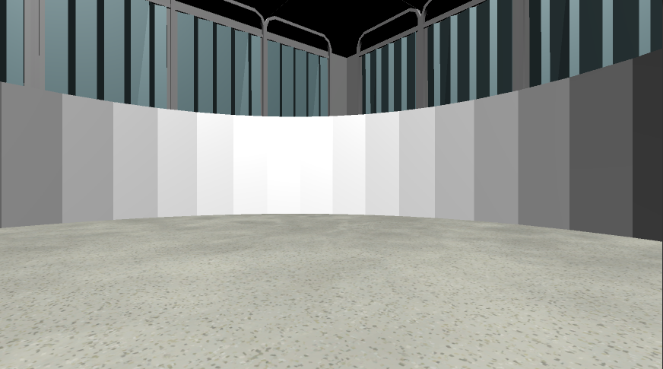

Welcome to the Final
Your first task is to collect as much as possible in each of the following Money Collection Rounds. On each round, you will be placed into one of the environments that you learned in the previous sessions Once in the environment you will have 1-minute to collect as much money as possible!!
1 Minute
Do you have any questions?

Slide 4
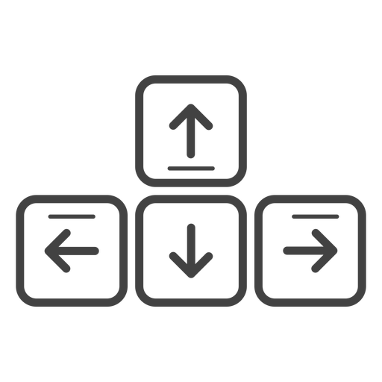
MOVEMENT CONTROLS
The controls are the same as previous sessions: use the Up-Arrow to move forward, and the left and right arrow-keys to rotate.
Move Forward
Rotate
Left
Rotate
Right

Slide 5

NO FEEDBACK ROUNDS
Unlike previous sessions, ALL rounds in this session are NO FEEDBACK rounds!
At the start of every round “Search For Money! NO FEEDBACK” screen.
During these rounds you will NOT hear a coin sound when you collect money and you will NOT be able to see how much you’ve collected!
Less than 10¢
10¢ or more
Search For Money!
No Feedback Round
Search For Money!
No Feedback Round
When you reach 10¢ the text will not change color and will remain Red. This means that you will not know whether you have collected more than 10¢. However, if you do collect more than 10¢ by the end of the round the money will be added to your Total Bonus Payment.
HINT: Use what you’ve learned from the Feedback Rounds to guide your search!
Do you have any questions?

Slide 6
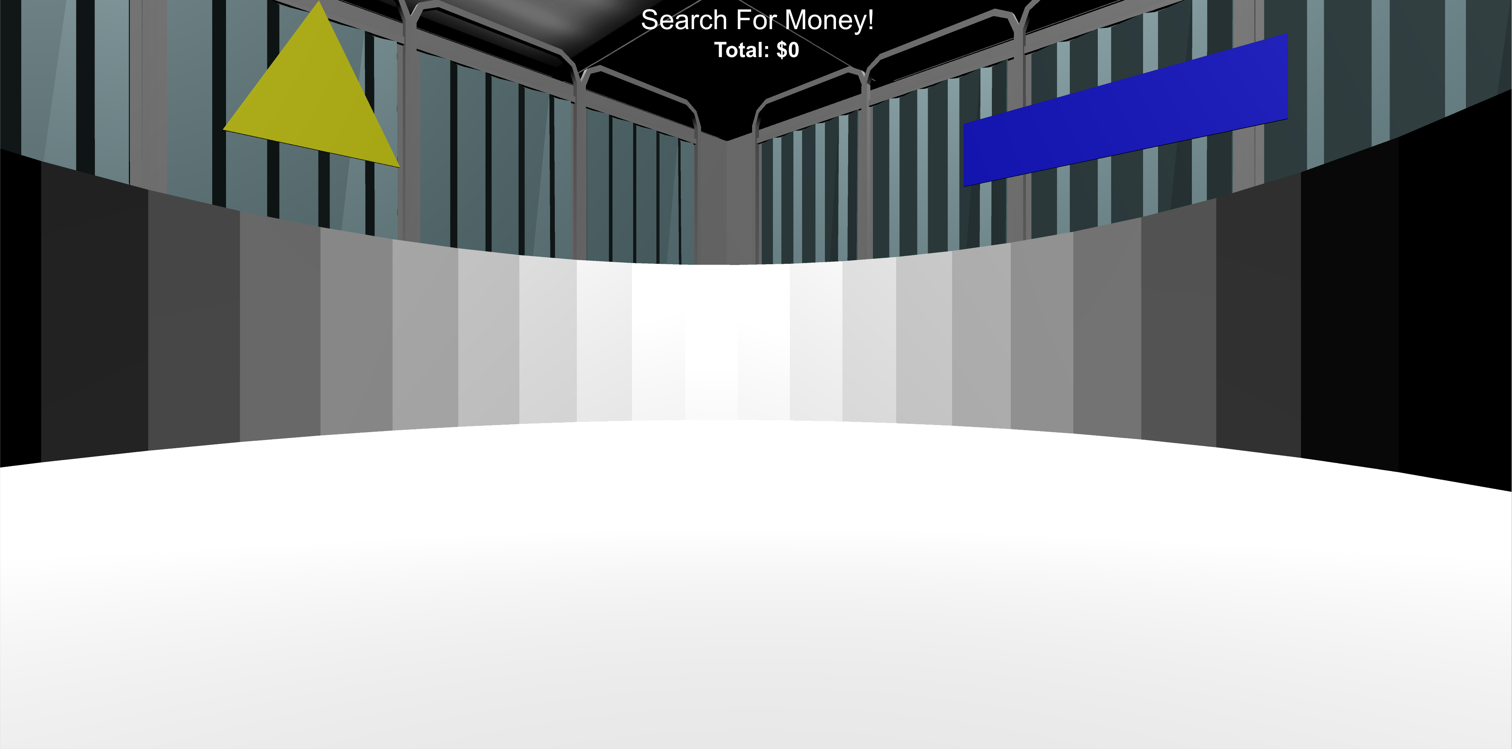
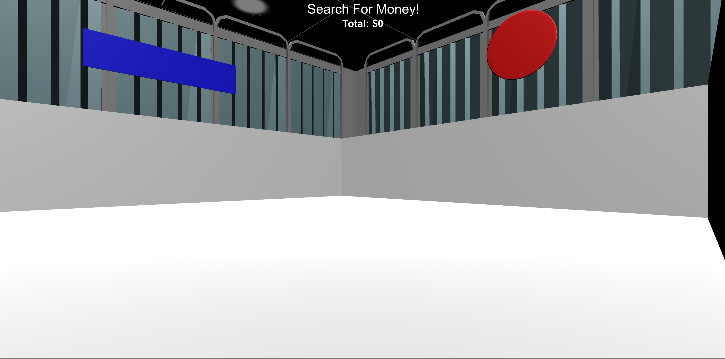
MONEY COLLECTION ROUNDS
In this session, all rounds are No Feedback Rounds:
no sound and no collection total!
you will see the “Search For Money! NO FEEDBACK” screen before being placed into the environment. Once in the environment you will have 1 minute to collect as much money as possible! You won't find out how much you’ve collected until the end of this session!

Slide 7
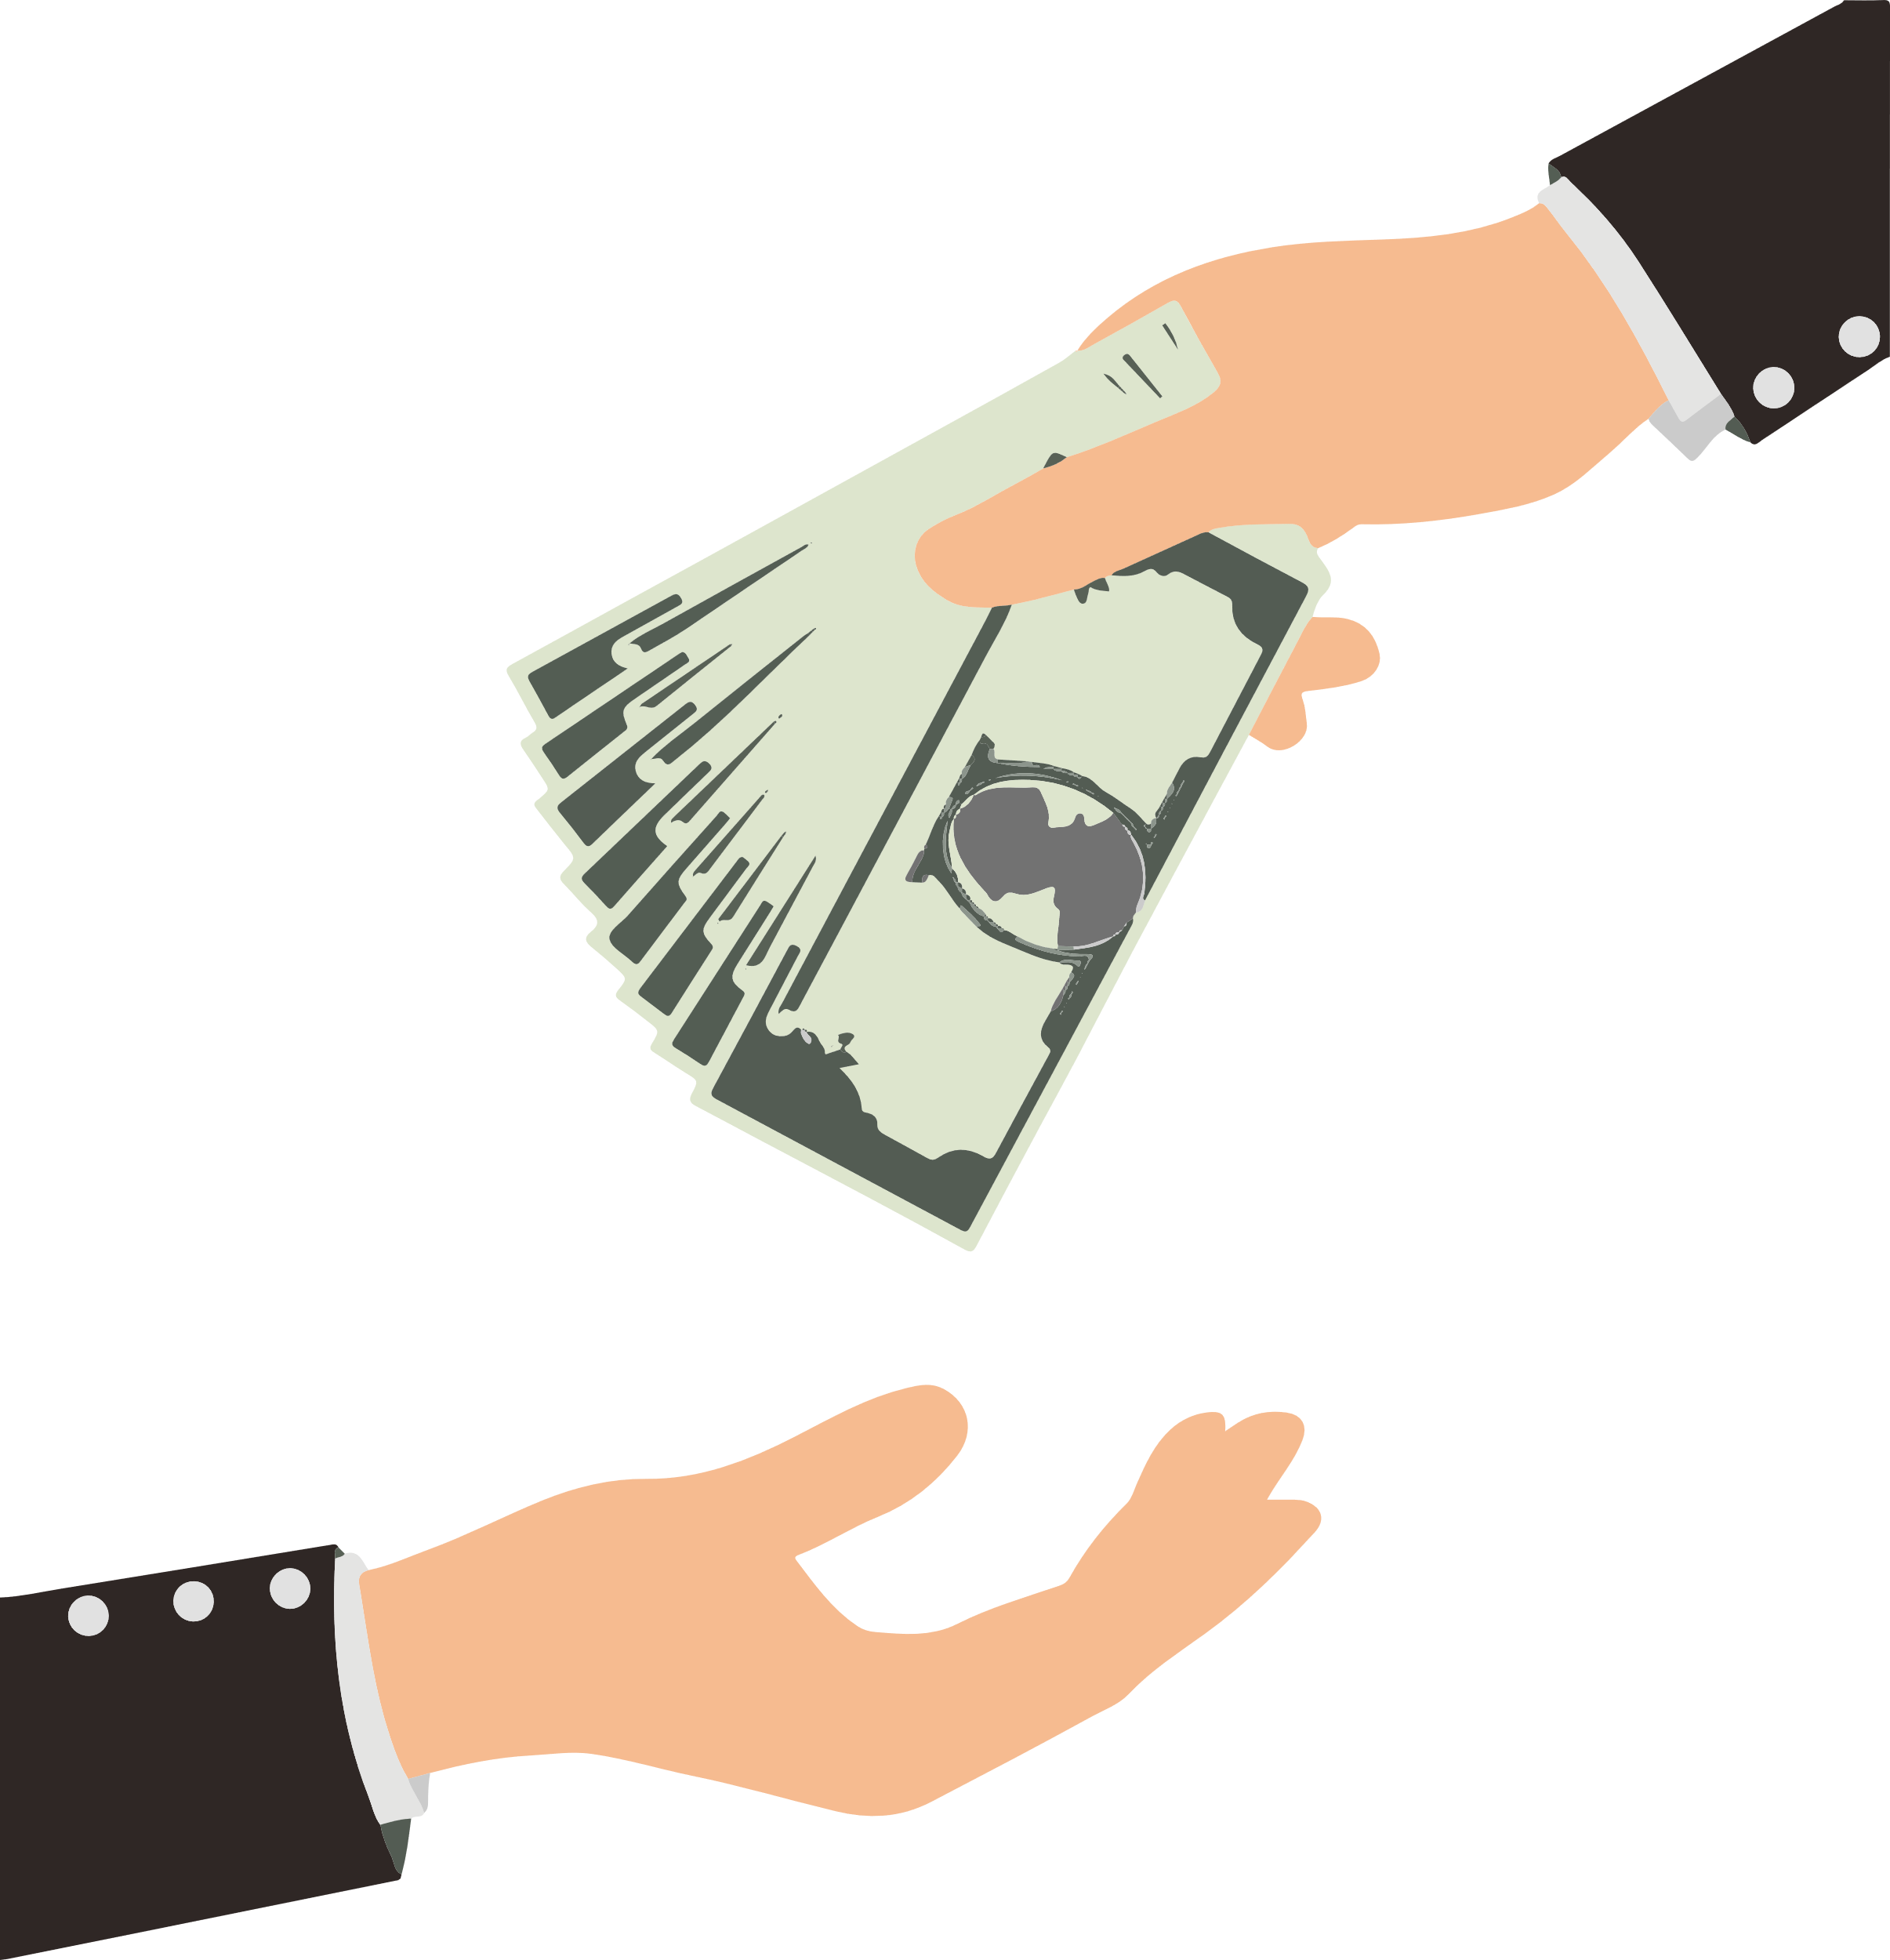
BONUS PAYMENT
There is an UNLIMITED amount of money to collect in each round and any money you collect you will receive as a BONUS PAYMENT at the end of the experiment!

Slide 8
HINT!!
Use what you’ve learned from previous sessions to guide your search!

Slide 9
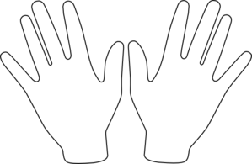
Ready?
When you’re ready, place your right hand on the arrow keys and press the Spacebar with your left to continue!
Spacebar

Slide 10
Great Work! Please notify the experimenter that you have completed this portion of the experiment.

Slide 11
VARIATION COLLECTION ROUNDS
In this next section of the experiment you will be placed in several variations of the environments that you have learned.
Again, you won’t receive any feedback when you collect money, so you will have to use what you learned in previous sessions to guide your search!
You will receive a bonus payment equal to the amount that you collect, but you won’t find out how much you’ve collected until the end of the experiment!
Good Luck!!

Slide 12
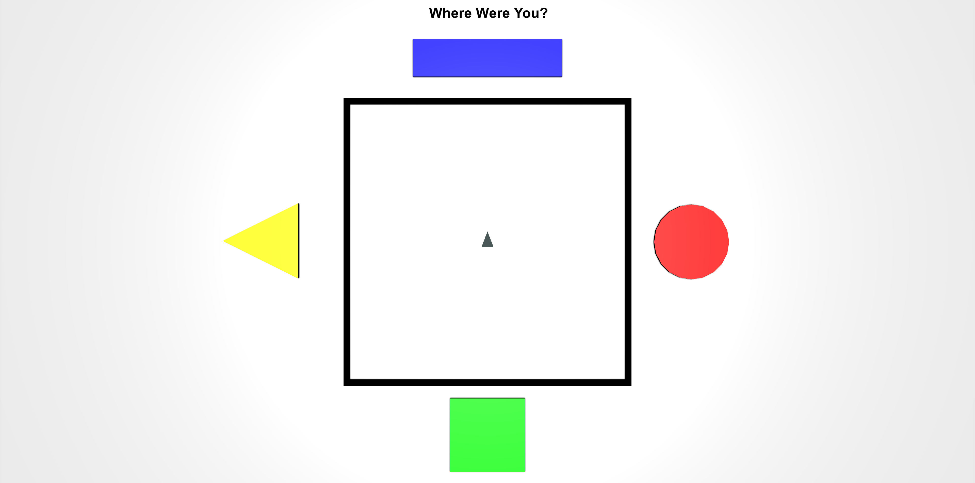
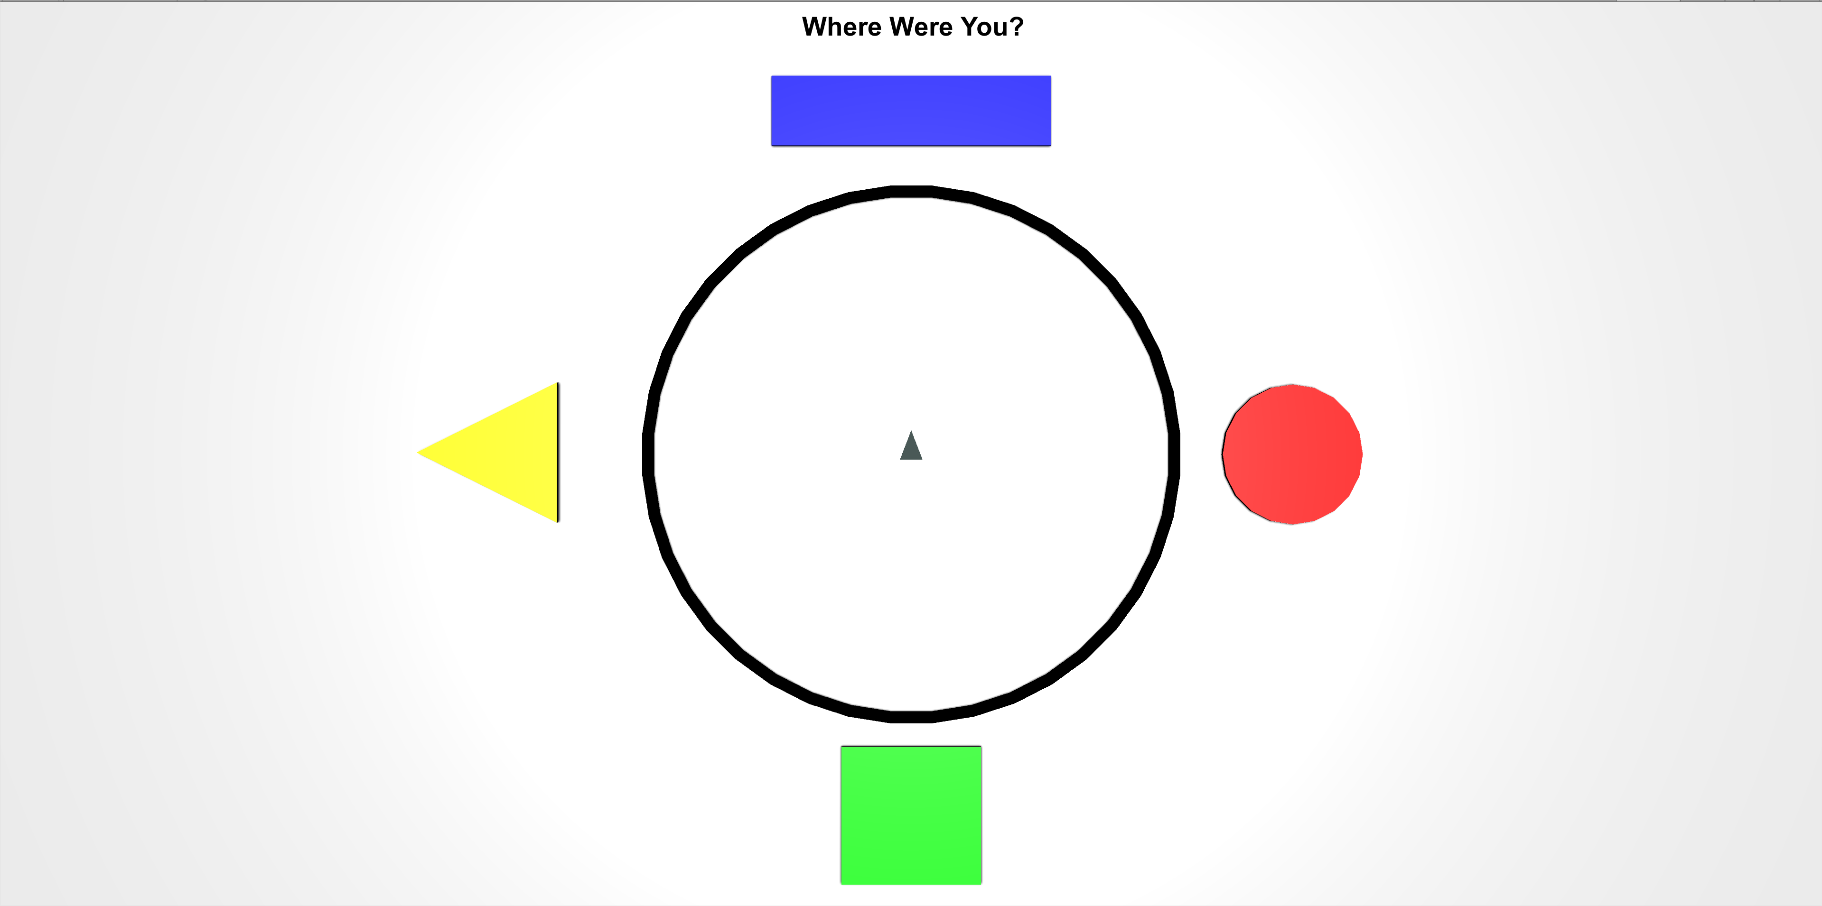
While refamiliarizing yourself with the environments, you will be asked periodically to locate your position from a top-down viewpoint like the ones pictured below.
The grey triangle in the middle shows the direction that you’re facing, and the controls are the same as the 3D environment. Move the grey triangle to the last position you were in, in the 3D environment and then press the Spacebar.

